Slide 1
TITLE: SECURE DATA Hiding in images using steganography
CAPSTONE PROJECT
Presented By : Reeha Thouheed
Student Name : Reeha Thouheed
College Name & Department : Institute of Aeronautical Engineering
Computer Science Engineering – Cyber Security

Slide 2
OUTLINE
Problem Statement
Technology used
Wow factor
End users
Result
Conclusion
Git-hub Link
Future scope

Slide 3
Problem Statement
Traditional data-hiding techniques often rely on complex encryption methods, making them difficult to implement for simple message concealment. This project aims to provide a basic steganography solution by embedding secret messages into images using pixel value modifications. By leveraging OpenCV, users can securely hide and retrieve messages with minimal image distortion.

Slide 4
Technology used
Programming Language: Python
Libraries:
OpenCV (cv2) – for image processing
OS module – for file handling
Concept: Image-based steganography
Methodology: Encoding and decoding messages by manipulating pixel values in an image
Operating System: Windows
Development Platform: VS Code
Version Control: GitHub – for code hosting and collaboration
Deployment: GitHub repository

Slide 5
Wow factors
Pixel-Based Message Encoding – Uses direct pixel value modifications to embed messages, ensuring simplicity and efficiency without requiring complex cryptographic methods.
Passcode Protection – Adds an extra layer of security by requiring a passcode for decryption, preventing unauthorized access to hidden messages.
Minimal Image Distortion – Maintains the visual integrity of the image while storing data, making it difficult to detect any modifications.
Customizable Message Length – Adapts to different image sizes, allowing users to hide varying amounts of data based on image resolution.
Lightweight and Fast Processing – Utilizes OpenCV for quick encryption and decryption, making it efficient for real-time applications without high computational requirements.

Slide 6
End users
Cybersecurity Enthusiasts
Journalists & Whistleblowers
Forensic Investigators
Privacy-Conscious Users
Educators & Students

Slide 7
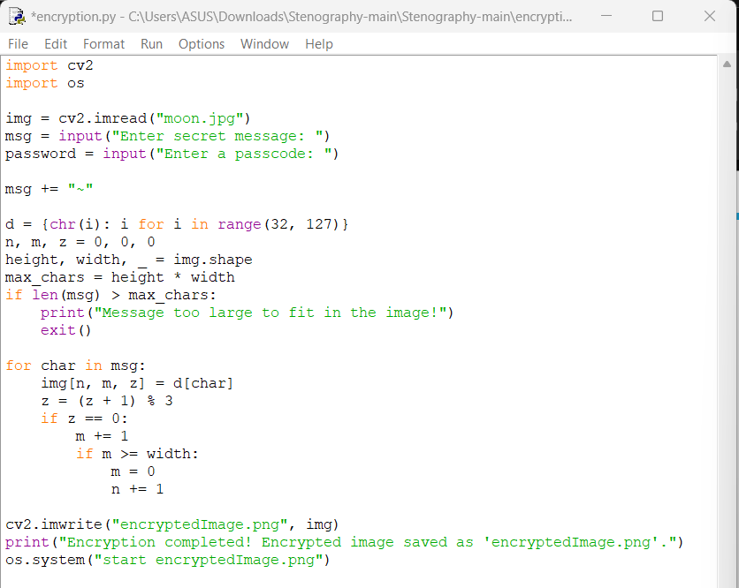
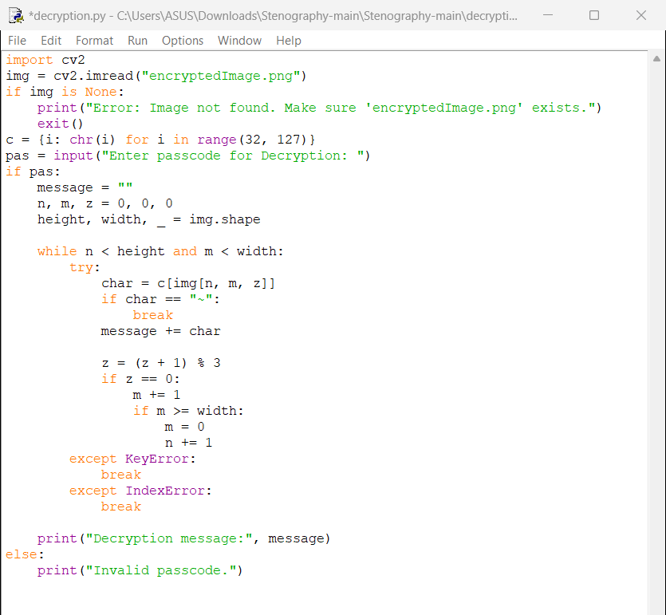
Results

Slide 8

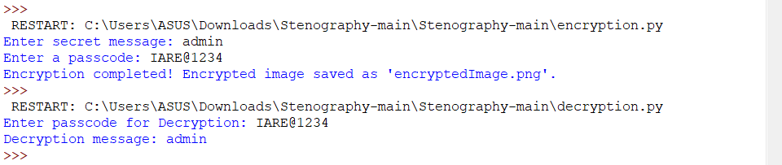
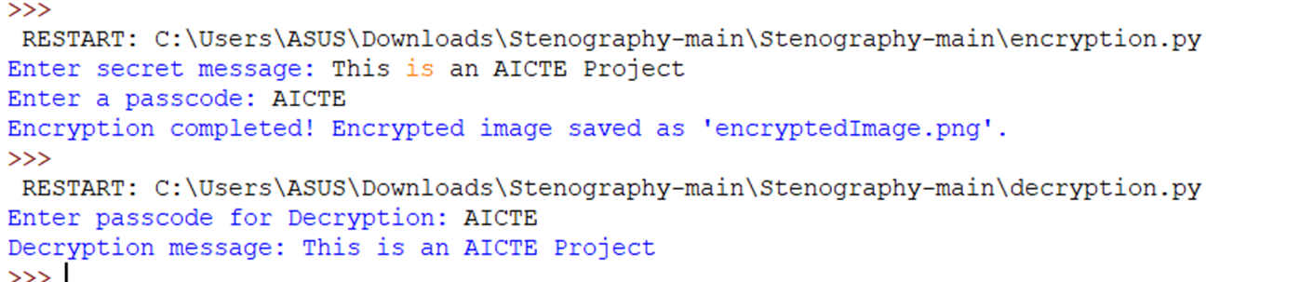

Anime.jpg
encryptedImage.png

Slide 9
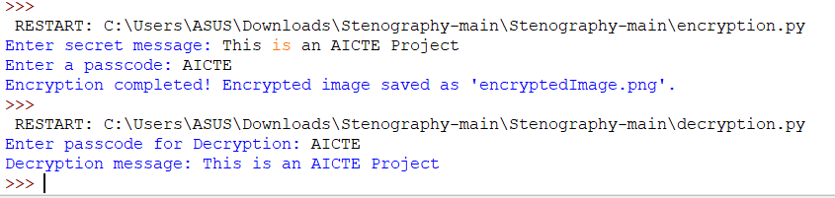

Slide 10
Conclusion
Steganography provides an effective and covert method of secure communication. Unlike traditional encryption, it does not attract unwanted attention. The implementation of this technique using Python and OpenCV showcases its feasibility, security, and practicality in modern cybersecurity and data protection.
Steganography provides an effective and covert method of secure communication. Unlike traditional encryption, it does not attract unwanted attention.
The implementation of this technique using Python and OpenCV showcases its feasibility, security, and practicality in modern cybersecurity and data protection.

Slide 11
GitHub Link
https://github.com/ReehaThouheed/Steganography_Edunet

Slide 12
Future scope (optional)
AI-Powered Steganography: Enhance security by making detection even more challenging.
Multi-Layer Encryption: Combine steganography with cryptographic techniques for double security.
Video & Audio Steganography: Extend the concept beyond images.
Cloud-Based Steganography: Secure cloud communications with embedded messages.
Mobile App Integration: Implement for Android/iOS for real-world use.

Slide 13
THANK YOU

